Slide 1
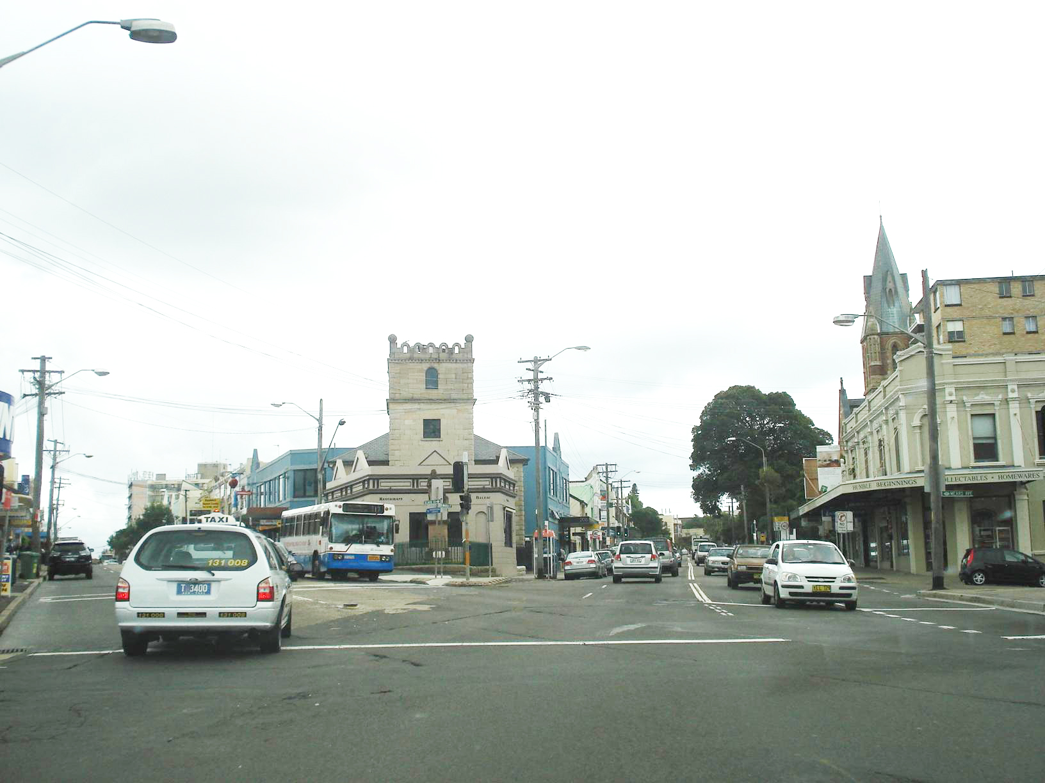

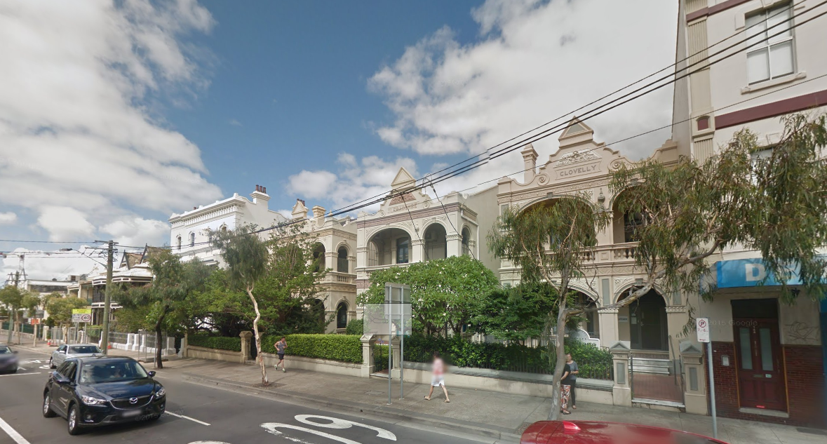
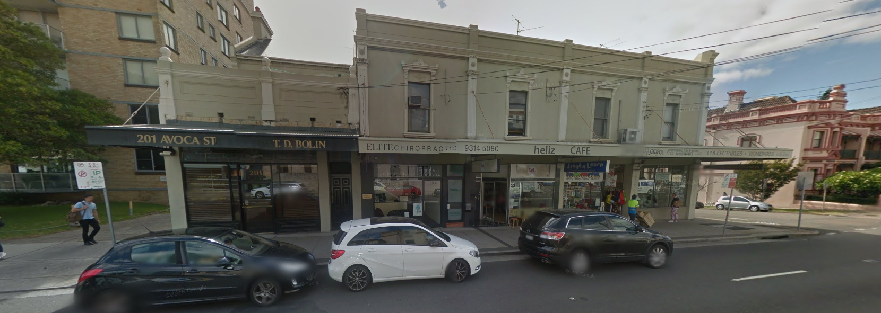
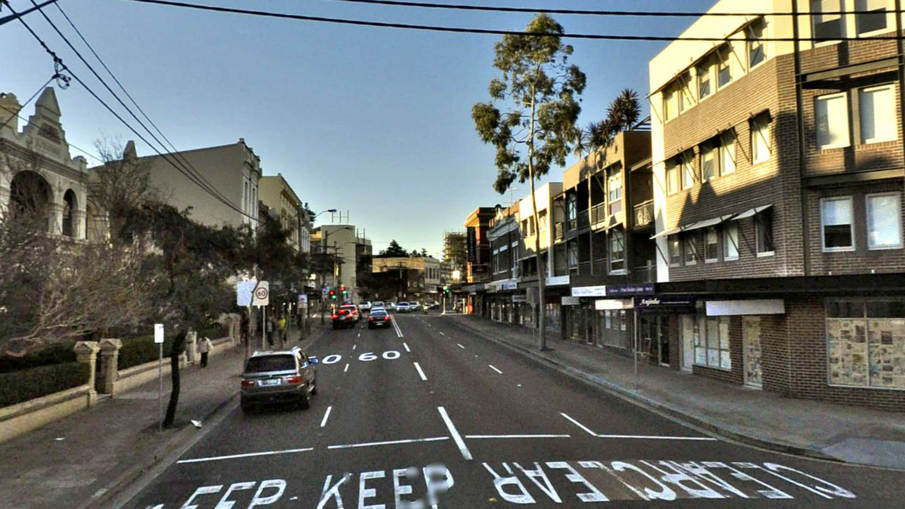
Randwick City Council
Randwick Junction Town Centre Review – Visitor Survey

Slide 2
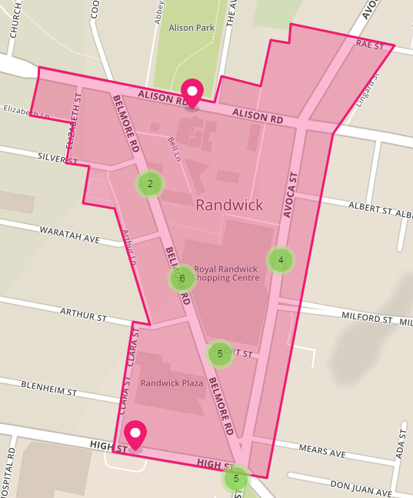
Survey highlights
Consultation period – 9 November 2016 to 6 January 2017
A dedicated ‘YourSay Randwick’ website was developed to capture the community’s feedback: www.yoursayrandwick.com.au /randwickjunction
We had:
  10 survey stalls across the Town Centre
  during the consultation period
  769 site visits to the dedicated YourSay
  Randwick webpage
  87 visitors downloaded our Randwick Junction
  Town Centre Review – Issues Paper
  497 survey submissions (252 at our face to
  face stalls, 245 submitted online)
  24 comments made on our
  interactive map
Your Say Randwick Interactive map

Slide 3
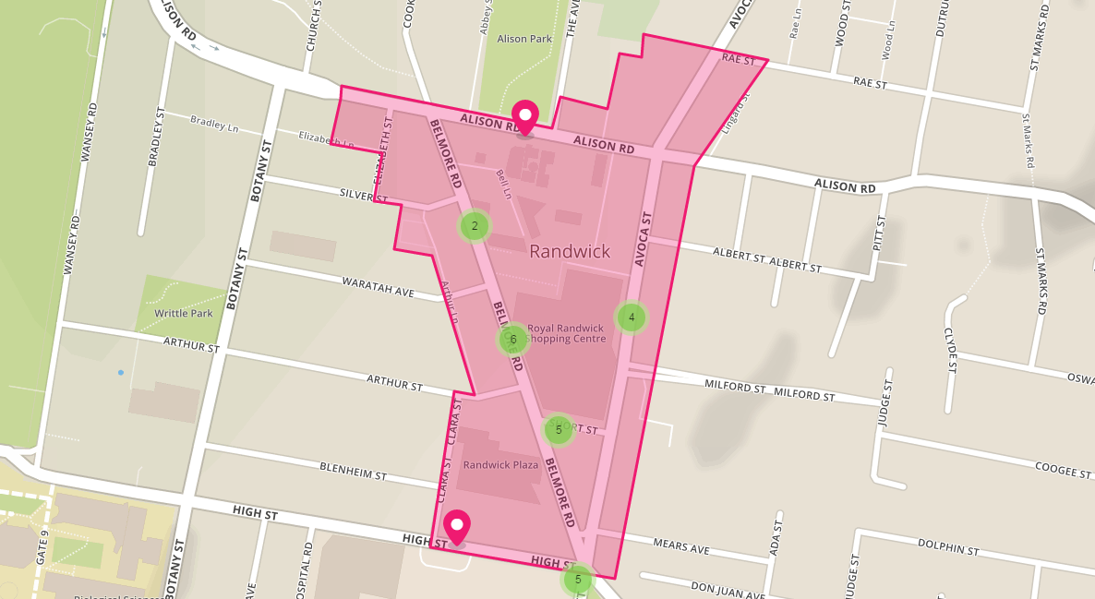
Sample of comments
“[Introduce] 30 or 45 degree to introduce density of parking” – M.
“Timed crossing required to stop constant flow of pedestrians which brings road to standstill”
– Matt
“Belmore Rd should be car free… make it pedestrian friendly and build a separated cycle lane along it”
– Boaz
“Too many jaywalkers endangering both pedestrians and drivers… traffic lights too far at both ends”
– RandwickTraveller
“Very interested in understanding the impacts on parking and roads near here due to the light rail” – Anon.
“Crossing here is a bit tricky as drivers turn in from both directions. How about a raised crossing?”
– Penszen

Slide 4
Survey highlights
The survey results told us:
  77% of respondents come to the Town Centre more than once a week
  46% of respondents get to the Town Centre by walking or bike
  91% live within 5km of the Town Centre
Key comments included:
  A pedestrian friendly environment, and street trees and landscaping were the two most important public domain issues reported
  Visitors like the friendly and welcoming atmosphere in the Town Centre
  Conflict between pedestrians and vehicles and difficulty finding parking were key issues identified

Slide 5
Results of survey
How often do you visit Randwick Town Centre?
Key finding
Almost four in every five visitors surveyed (77%) come to the Town Centre more than once a week

Slide 6
Results of survey
How do you get to Randwick Town Centre?
Key finding
Almost half (46%) of visitors surveyed get to Randwick Town Centre by active transport – walking and cycling

Slide 7
Results of survey
How far do you live from the Town Centre?
Key finding
91% of visitors surveyed live within 5km of the Town Centre

Slide 8
Results of survey
What is the purpose of your visit to the Town Centre?
Key finding
Most visitors identified multiple reasons for coming to the Town Centre, with shopping, eating/drinking, and accessing services (such as banks and medical providers) the most common identified

Slide 9
Results of survey
How important are the following features to you when visiting the Town Centre?
Key finding
  A pedestrian friendly environment, and street trees and landscaping were the two most important public domain issues reported

Slide 10
Results of survey
When thinking about your time in the Town Centre, how would you rate your experience?
Key finding
Almost half of respondents rated street trees and landscaping, as well as seating and outdoor space as either “poor” or “very poor”

Slide 11
Results of survey
What do you like about the Randwick Junction Town Centre?
What you said you liked…
There is a good variety of shops, services and facilities (207 comments)
It’s convenient to get to and close to home and/or work (126 comments)
Friendly and welcoming atmosphere (67 comments)
Good variety of places to eat, including cafes, restaurants and casual food outlets (67 comments)
The town centre is compact and low scale (54 comments)
Good access to public transport (33 comments)
There is good range of parking options, with ‘free’ parking available (21 comments)
An appreciation for the “historic feel” of Randwick Junction (21 comments)

Slide 12
Results of survey
What do dislike about the Randwick Junction Town Centre?
What you said you didn’t like…
Traffic congestion (132 comments):
Pedestrian accessibility is difficult (102 comments):
  Both for pedestrians and vehicles on Belmore Road,
  For pedestrians crossing Avoca St, and
  Footpaths are narrow, uneven, and cramped
Streetscape is run down (91 comments)
Parking is hard to access, not well designed (84 comments)
Not enough landscaping or open space (54 comments)
Not enough variety of shops (43 comments)
Lack of outdoor seating to eat, mingle, ‘hang out’ (31 comments)
Lack of bicycle access and parking, with cyclists also on the footpaths (22 comments)

Slide 13
Results of survey
Where were you from?

